Slide 1
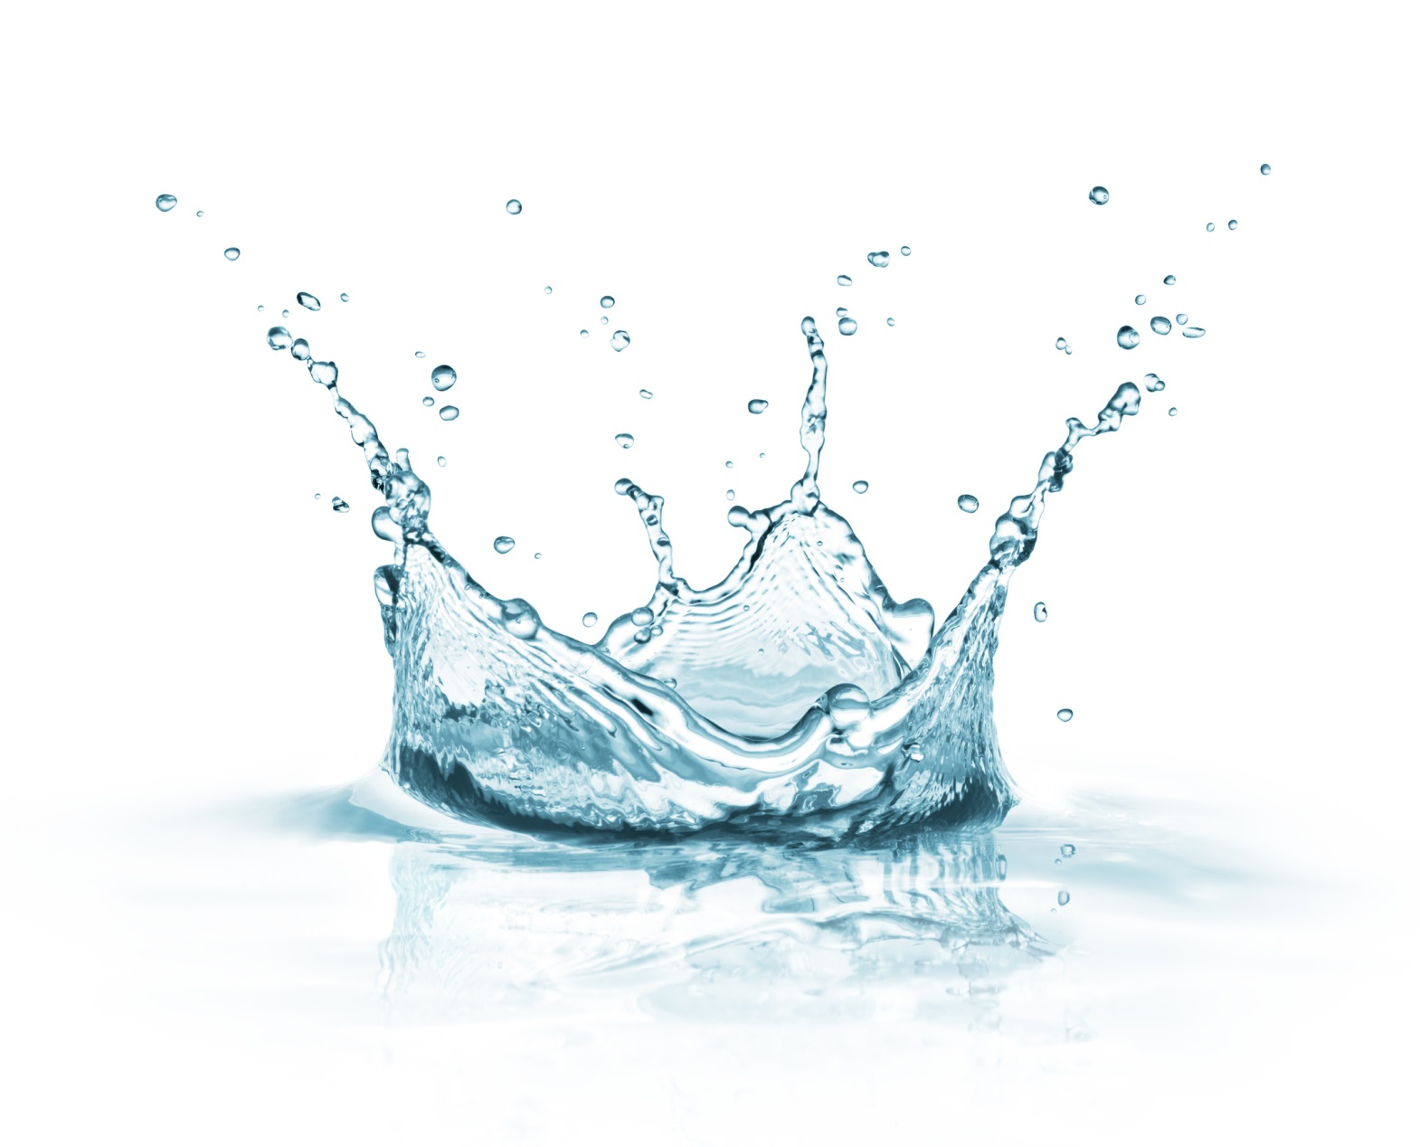
WATER
Journalists
Alexandra Laufova,Kristina Rusinova,
Viktoria Mincicova,Laura Morovska

Slide 2
Is Water a Mineral?
If we compare the properties of water to the five requirements of the mineral definition we find that it fails to qualify as a mineral. Water is a liquid so it does not meet requirement #3 - being a solid
However, at temperatures below 32 degrees Fahrenheit or 0 degrees Celsius water becomes the solid material that we call "ice"

Slide 3
Water–the basis of life
Some believe that the need to drink per day for 3-3. 5 liters of water
The water contains calcium, sodium, iodine, iron, magnesium, fluoride, copper and other biochemical processes
There are different views on how to use the water
Some improving techniques recommended to “taking” the water in the morning on an empty stomach, and it should be hot

Slide 4
What is Mineral Water?
Mineral water is something entirely different. Here the word "mineral" is used in reference to dissolved solids that occur in the water as it is taken from a natural source such as a spring
Natural mineral waters are found at many locations worldwide and vary widely in composition.
Under other circumstances these waters are bottled and sold to people who believe that the dissolved "minerals" might provide a health benefit

Slide 5
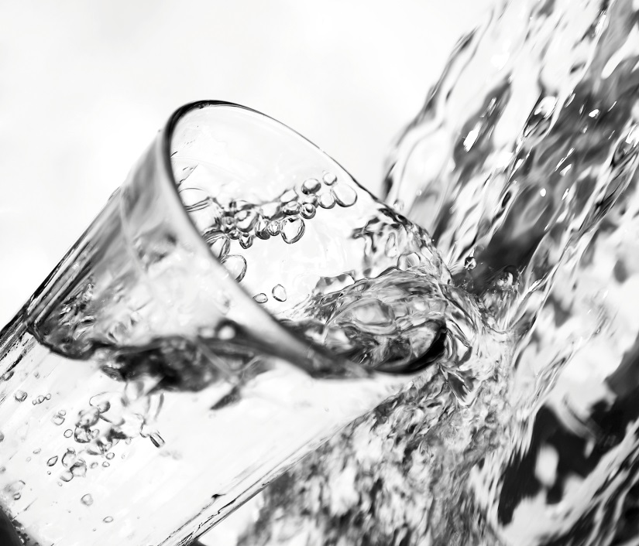
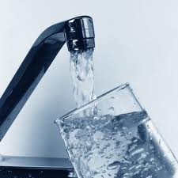
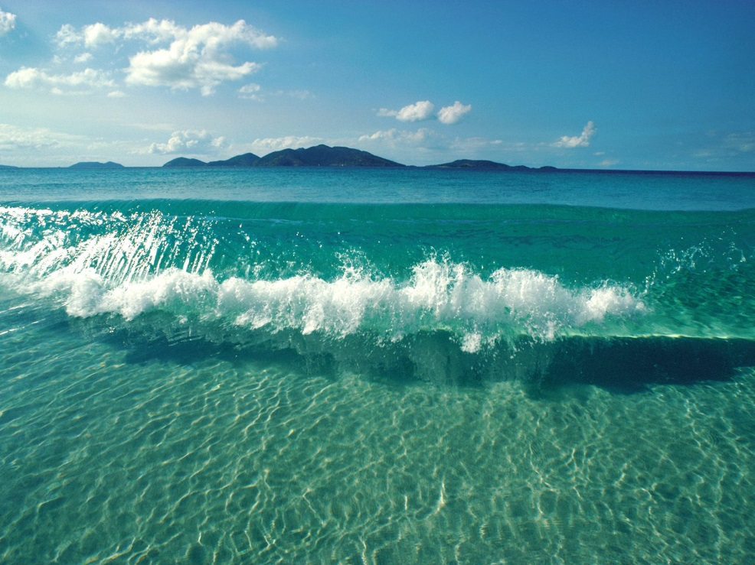
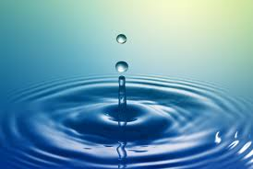

Slide 6
Floods
Flooding is the world’s most expensive type of natural disaster. The cost of global flood damage is hundreds of billions of euros. The Pakistan floods of July 2010 alone caused more than €7 billion euros of damage.
Floods can occur in coastal areas or close to rivers. When huge sheets of water cover low-lying areas, they can cause immense damage to property and threaten lives.
European space technology is a key weapon in the fight against floods. The first line of defence is provided by the Meteosat and MetOp weather satellites. These show developing storm systems and allow accurate forecasts of wind and rain.

Slide 7
World’s worst water disasters
1913 Great Lakes storm
1931 China floods
1912 sinking of RMS Titanic and 1987 sinking of MV Doña Paz
1970 Bhola Cyclone and 2008 Cyclone Nargis
1989 Exxon Valdez Oil Spill and the 2010 Deepwater Horizon oil spill
2004 Indian Ocean Tsunami
2005 Hurricane Katrina

Slide 8
Facts
More than 3.4 million people die each year from water, sanitation, and hygiene-related causes. Nearly all deaths, 99 percent, occur in the developing world
An American taking a five-minute shower uses more water than the average person in a developing country slum uses for an entire day
At birth, water accounts for approximately 80 percent of an infant’s body weight
By the time a person feels thirsty, his or her body has lost over 1 percent of its total water amount
The weight a person loses directly after intense physical activity is weight from water, not fat

Slide 9
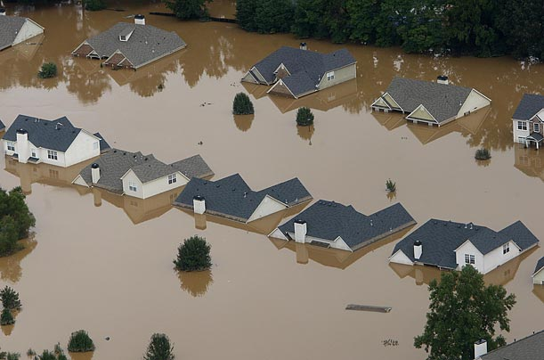
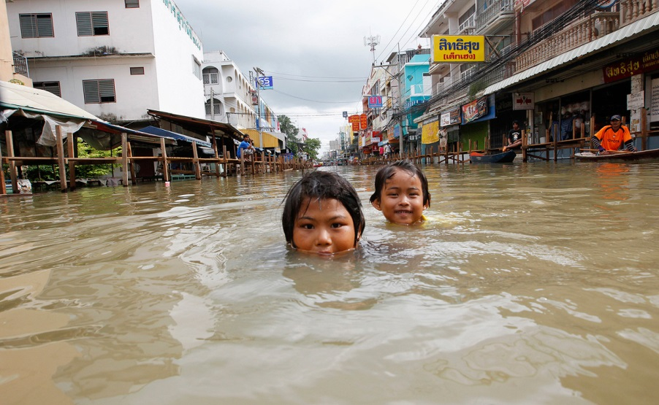
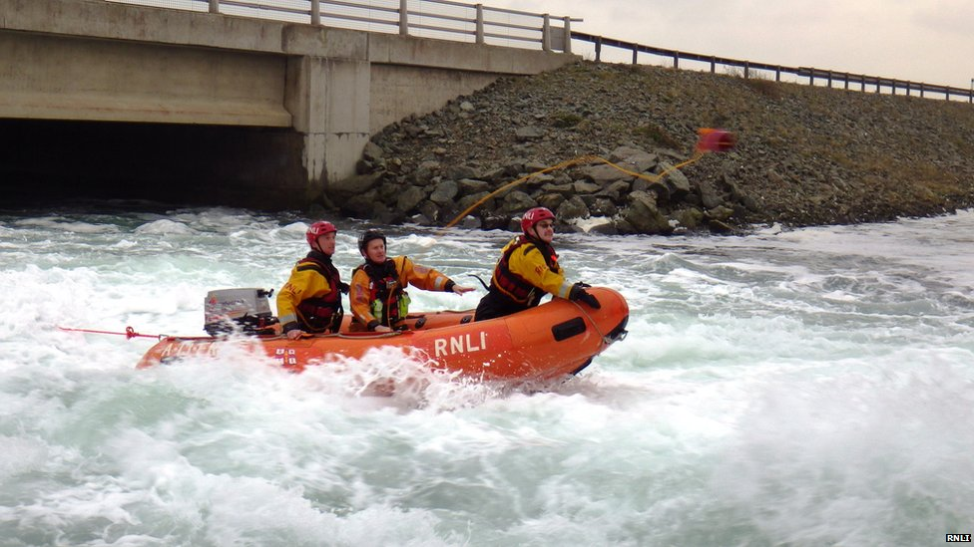

Slide 10
How much water do you use?
Showering
Brushing teeth
Bath
Toilet flush
Drinking,cooking,etc.
Washing machine
Dishwasher
Washing car

